Slide 1

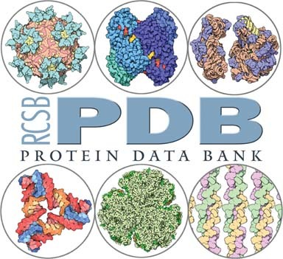
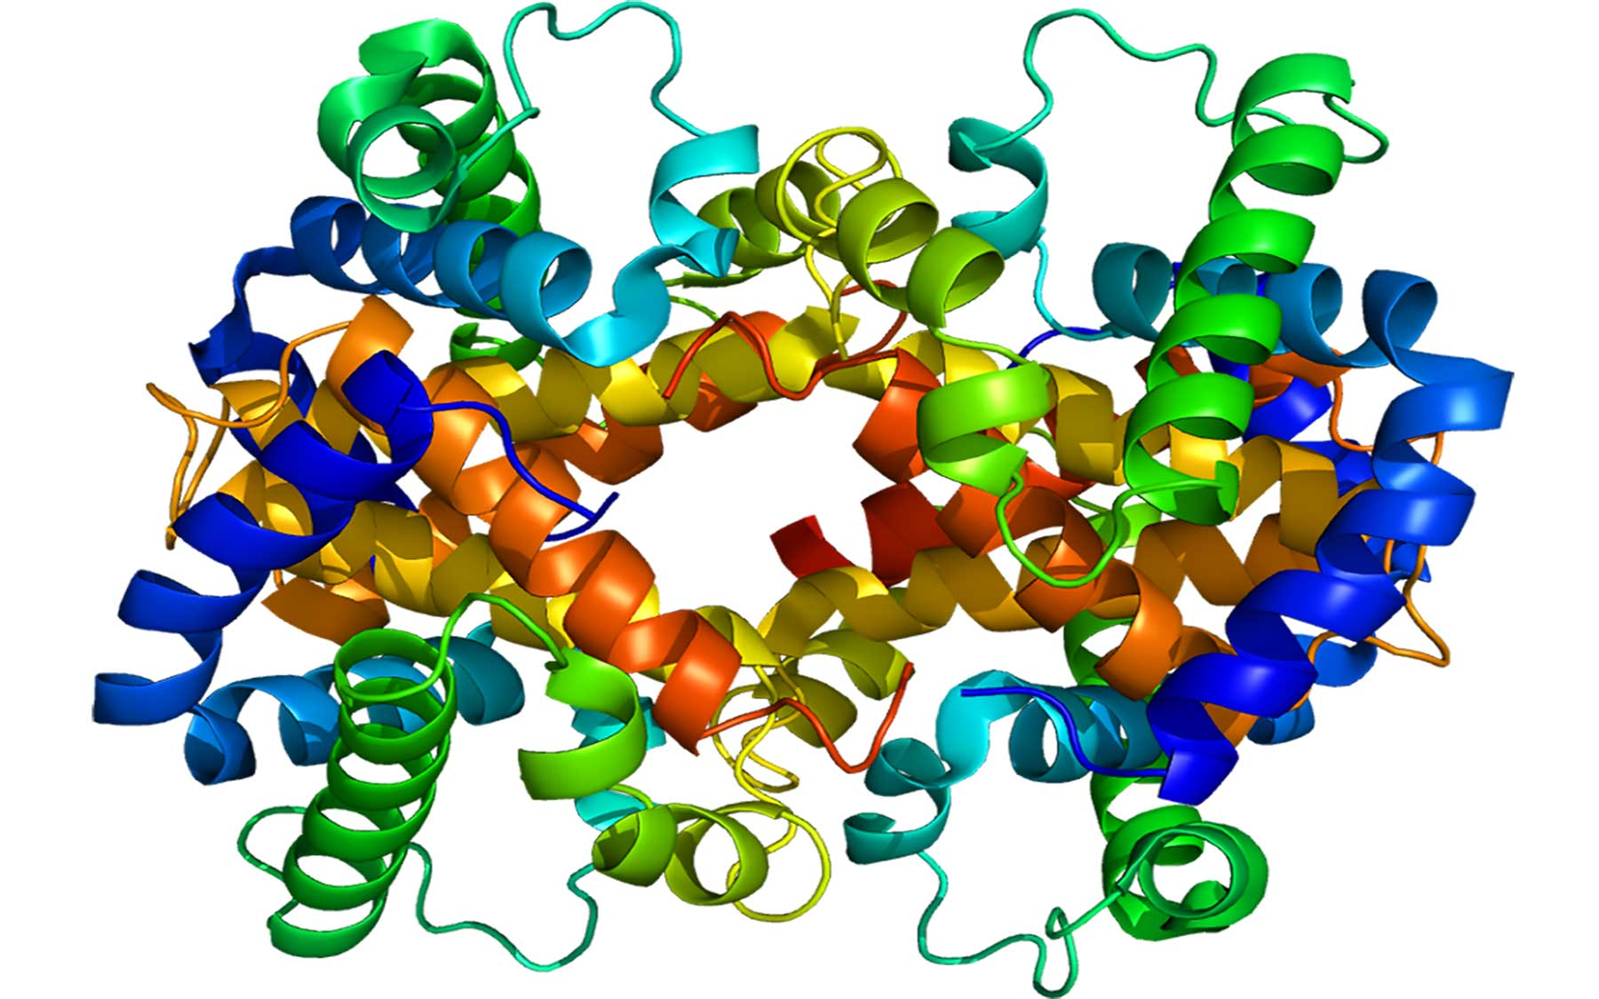
Proteins – protein database and enzymes

Slide 2
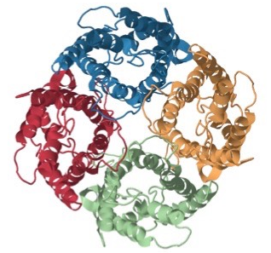
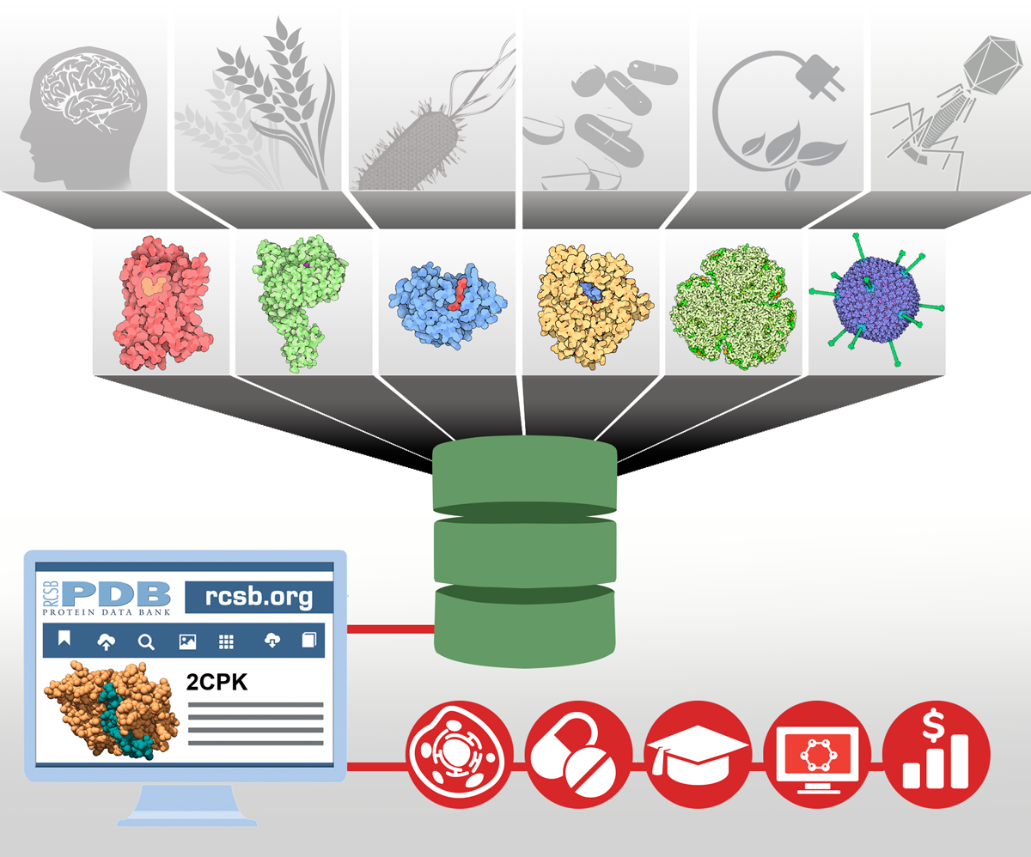
The Protein Data Bank
The PBS is an online database of macromolecular structures
It is overseen by the Worldwide Protein Data Bank (wwPBS) and is now an international endeavour
The data is freely accessible to all
An entry contains information about the primary, secondary, tertiary and quaternary structure of a protein

Slide 3
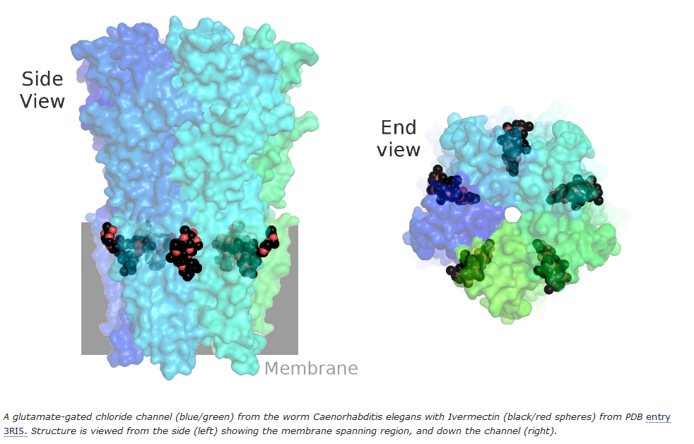
The Protein Data Bank
Information used in scientific research
Example: use protein structures to explore the causes of diseases or to develop treatments for diseases.
Video showing link between structure and function of proteins:
https://www.youtube.com/watch?v=wvTv8TqWC48

Slide 4
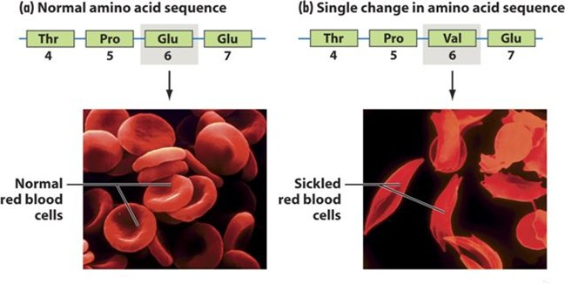
Sickle Cell Anaemia
Disease due to an error in protein primary structure.
Just one amino acid difference between normal and diseased haemoglobin
The error in primary structure impacts the overall structure and function of red blood cells
The shape of the red blood cells can block thin capillaries and cause pain. Cells have much shorter life and leaves person less efficient in transporting oxygen. Interestingly they do have a resistance to Maleria.
http://4.bp.blogspot.com/_Ij2obaIxCLA/TOgYQxUFw3I/AAAAAAAAAAk/XaS6nlwScdw/s1600/norm+sickel.jpg

Slide 5
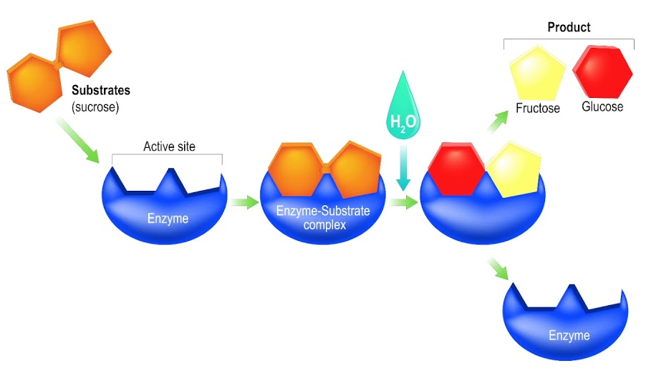
Enzymes
Biological catalysts – enzymes catalyse many processing in living systems. These complex molecules have 3-dimensional structures that allow it to selective interact with specific substrates. Enzymes decrease Ea and direct the orientation of substrates.
Called the “LOCK and KEY” model

Slide 6
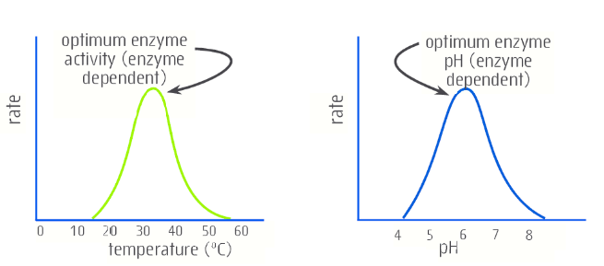
Enzymes
Enzyme activity is affected by temperature and pH
Enzyme’s conformation (shape) change under different conditions and this may inhibit the activity

Slide 7
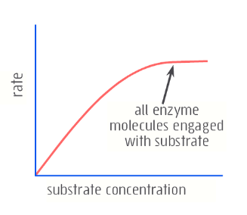
Enzymes
Recall – increasing concentration causes increases in rate of reaction
Now consider an enzyme – the reaction will only occur at the active site, so when you increase the concentration of the substrate the rate will increase initially until all of the active sites are filled, then the rate will stabilise.

Slide 8
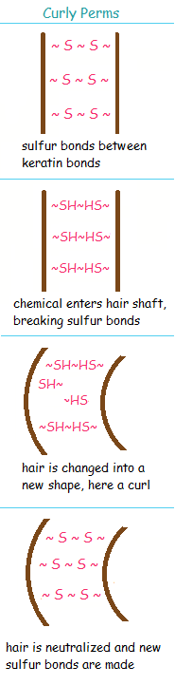
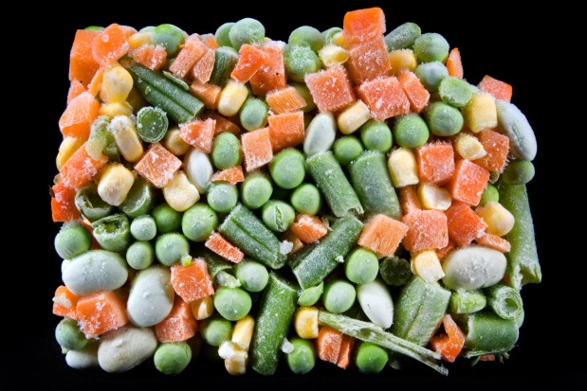

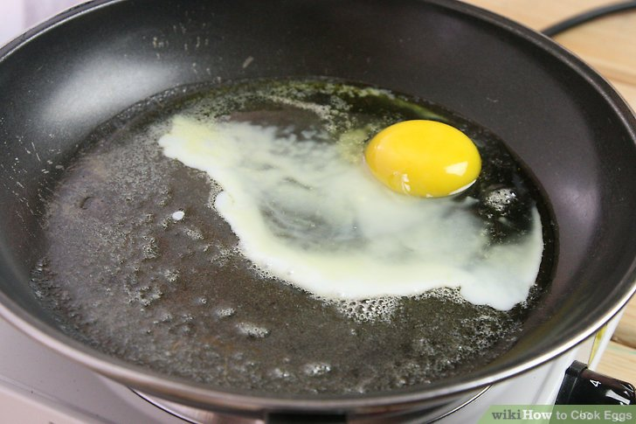
Denaturing proteins
Heat, pH change and some chemicals can disrupt the secondary, tertiary and quaternary structures
This changes the appearance of the protein from its natural state and the protein looses its function.
Some everyday examples include:
Cooking proteins
Hair perming
Ceviche (cook in acid)
Blanch vegetables before freezing to inactivate enzyme that decolours food.

Slide 9
On going work
Essential chemistry set 20
STAWA set 28 and 29 (amino acid and protein)

